Slide 1
FCS Calibrator
10/21/2025

Slide 2
Supported Cytometers
Supported Instruments:
CytoFLEX
CytoFLEX S
CytoFLEX LX
CytoFLEX Nano
ImageStream
CellStream
Cytek Aurora 5 Laser
Cytek Aurora 4 Laser
Cytek Aurora 3 Laser
Cytek Northern Lights 3 Laser
Cytek Northern Lights 1 Laser
Supports both unmixed and raw data for Cytek Instruments

Slide 3
What it Does
Compensation or Unmixing of flow cytometer data (.fcs)
Calibrates data from arbitrary units to real units that are comparable across instruments
Supported Calibration Types:
MESF Calibration: Calibrates data to units of Mean Equivalent Soluble Fluorophore
ABC Calibration: Calibrates data to units of Antibody Binding Capacity
Vesicle Size Calibration: Calibrates data to get size parameters
Requires dye that stains proportionate to surface area
Parameters: Diameter (nm), Surface Area (nm2), Volume (nm3)

Slide 4
Current Features
Calibrator Features
Detects fluorophores and sample types by reading keywords and filenames.
Assigns files as controls and configures how they relate to each other for unmixing based on fluorophore and sample tag values.
Functionality to mitigate issues caused by lacking appropriate unstained or background controls.
Generated plots for gating controls based on sample type and fluorophore (automated gating not implemented yet).
Unmixes or Compensates the data if the input data was not already unmixed/compensated.
Assigns the unmixed/compensated parameters a calibration type based on fluorophore. Generates plots for gating where applicable.
Exports the calibrated datafiles along with metadata describing everything that was done.

Slide 5
In Progress
Q and B calibration for statistical photoelectrons to allow photon estimates of a measurement.
Allow spectral plot(s) showing overlay of (predicted) components for a given event or datafile as determined by Ordinary Least Squares.

Slide 6
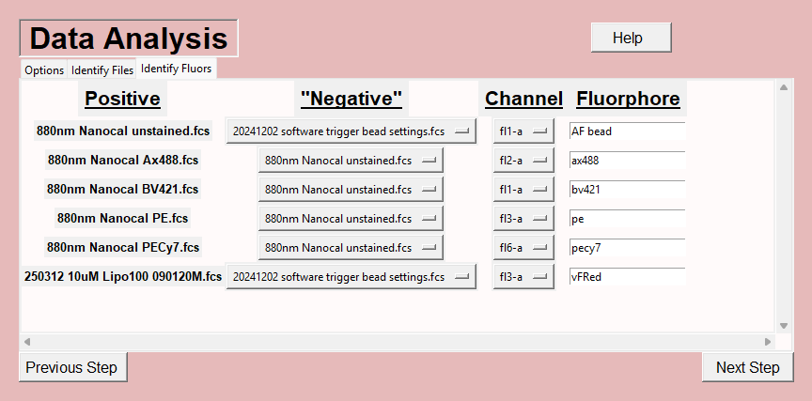
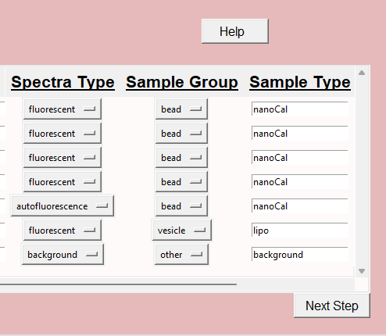
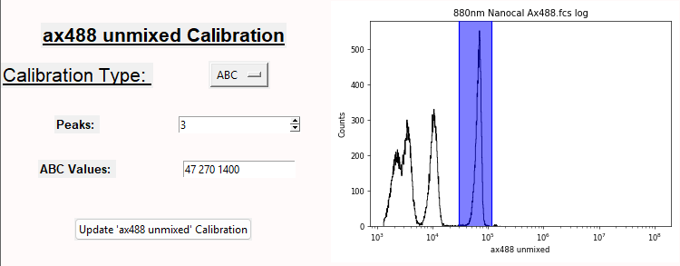
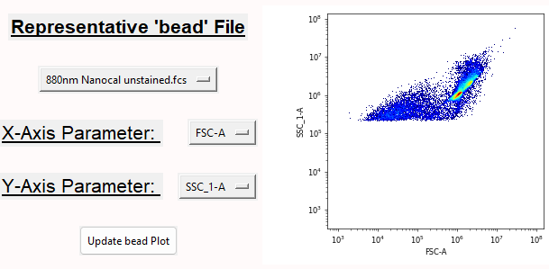
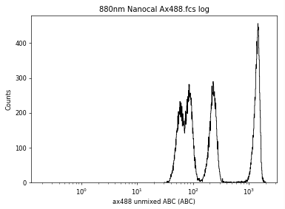
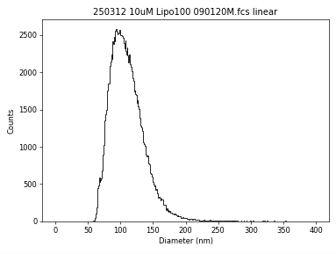
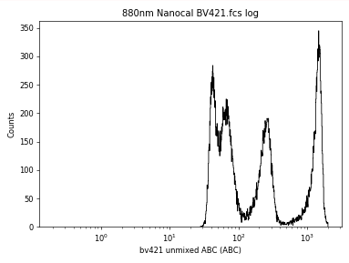
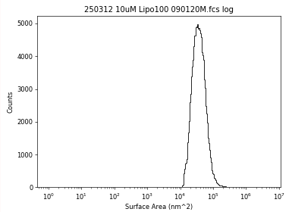
How It Works
1. Reads keywords and filenames to identify sample type and fluorophore
2. User draws a sample gate for each type of sample and peak gates for each fluorophore
3. Unmixes/Compensates and calibrates the data (where applicable).
4. Export Data with calibrated parameters to use in 3rd party software.

